Slide 1
CS236
Discrete Structures

Slide 2
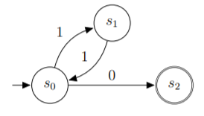
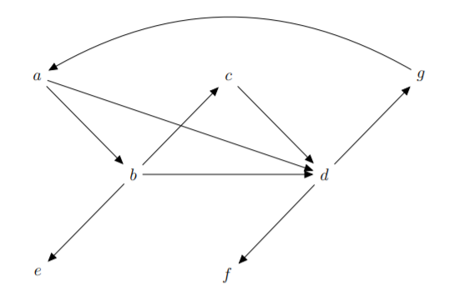

Course Goals – Math Concepts for CS
Learn three key Schemas:
Machines and Languages
Logic and Relations
Graphs and Algorithms
Notes:
What is a schema: a representation of information and how it is used

Slide 3
Course Goals – Math Concepts for CS
This is a “math-first” class
Applied to databases
Each project uses a different piece of math
Notes:
What is a schema: a representation of information and how it is used

Slide 4
Course Assignments
5 Projects – all connected; the final project is one large system
~26 HWs – due on Monday, Wednesday, or Friday
1 Midterm
1 Final Exam – cumulative

Slide 5
Things to Notice on Learning Suite

Slide 6
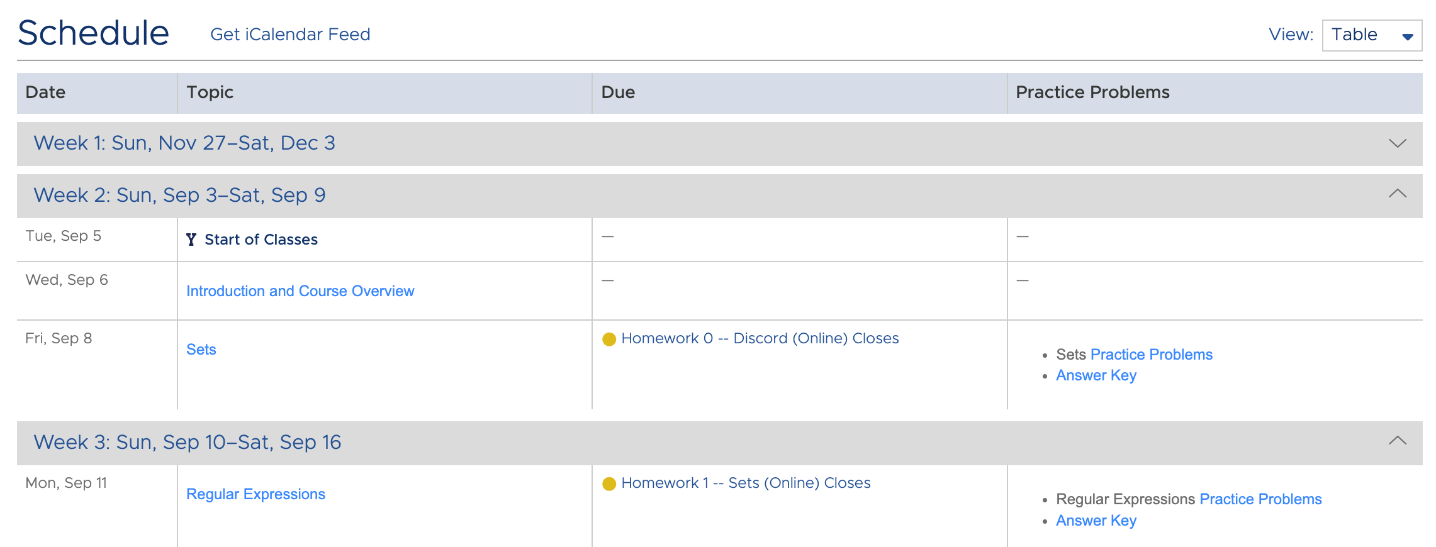
Many homework assignments are online
Learning Suite can only do these via their exam tool which makes scheduling weird
These dates are just for managing the assignments

Slide 7
Clicking on the lecture topic …

Slide 8
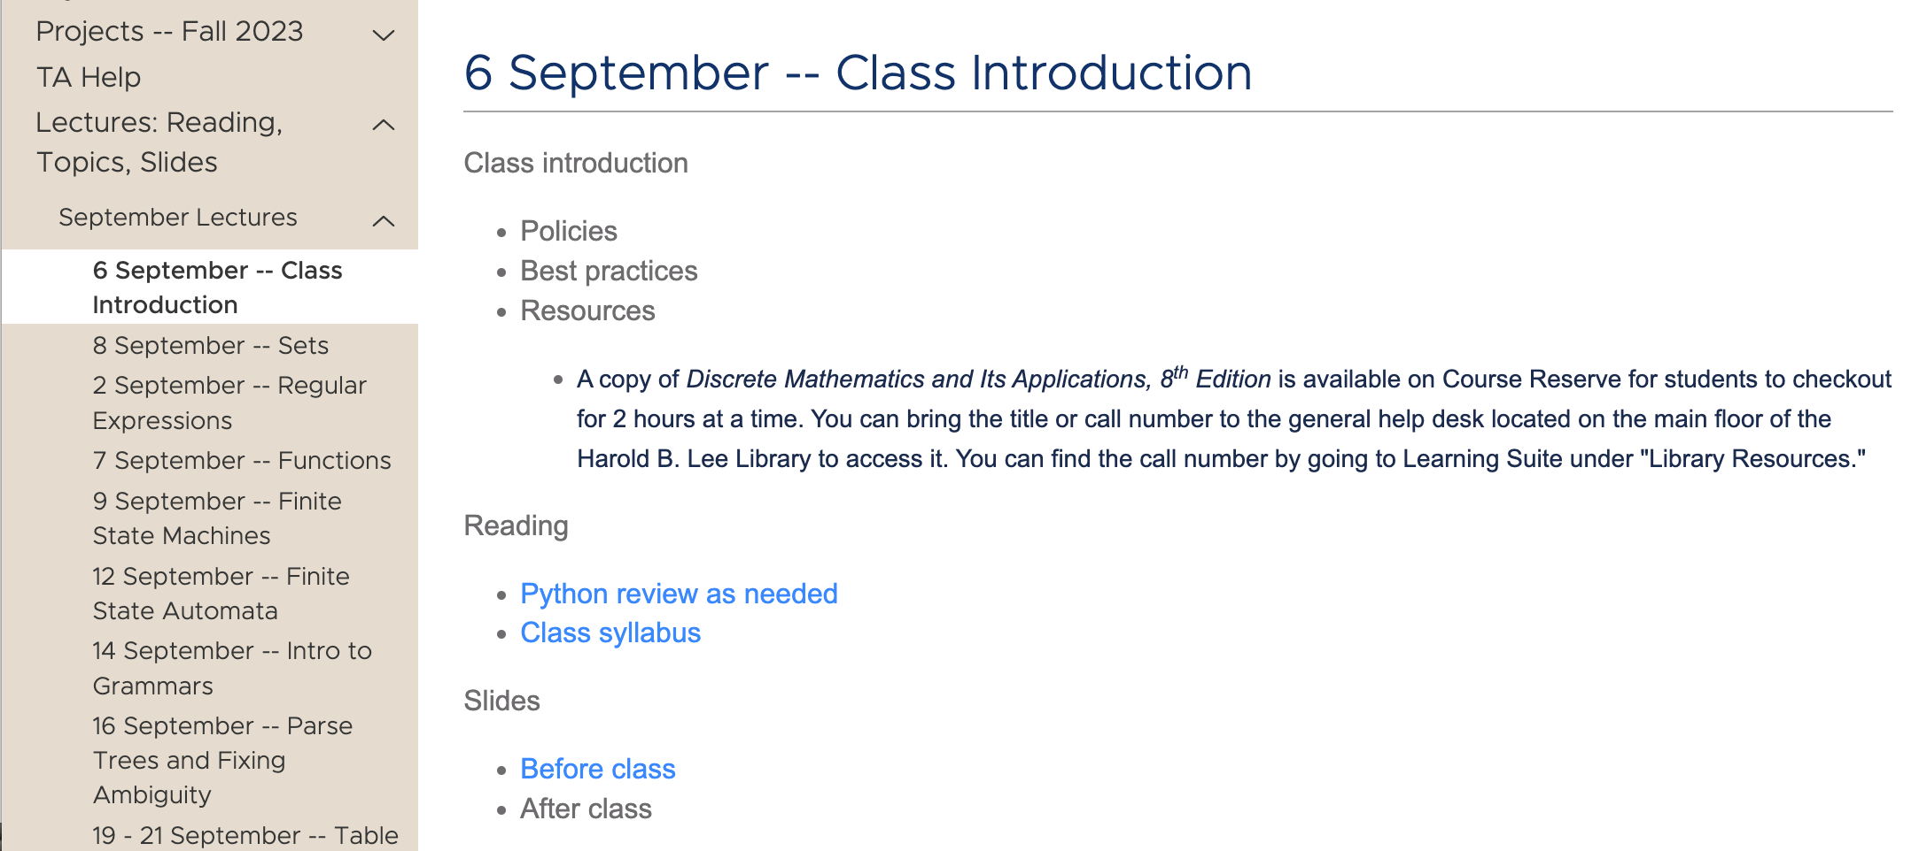
Takes you to the Course Content Tab, Lecture

Slide 9
List of topics
Assigned reading or viewing
Slides: before and after class

Slide 10
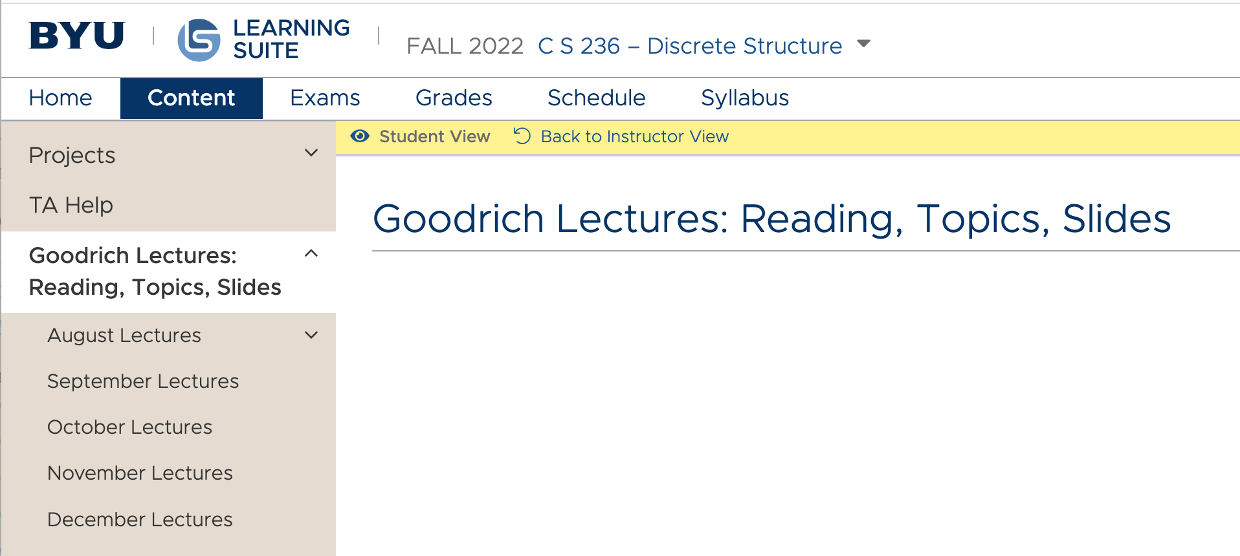
Can get to lectures directly via course content tab

Slide 11
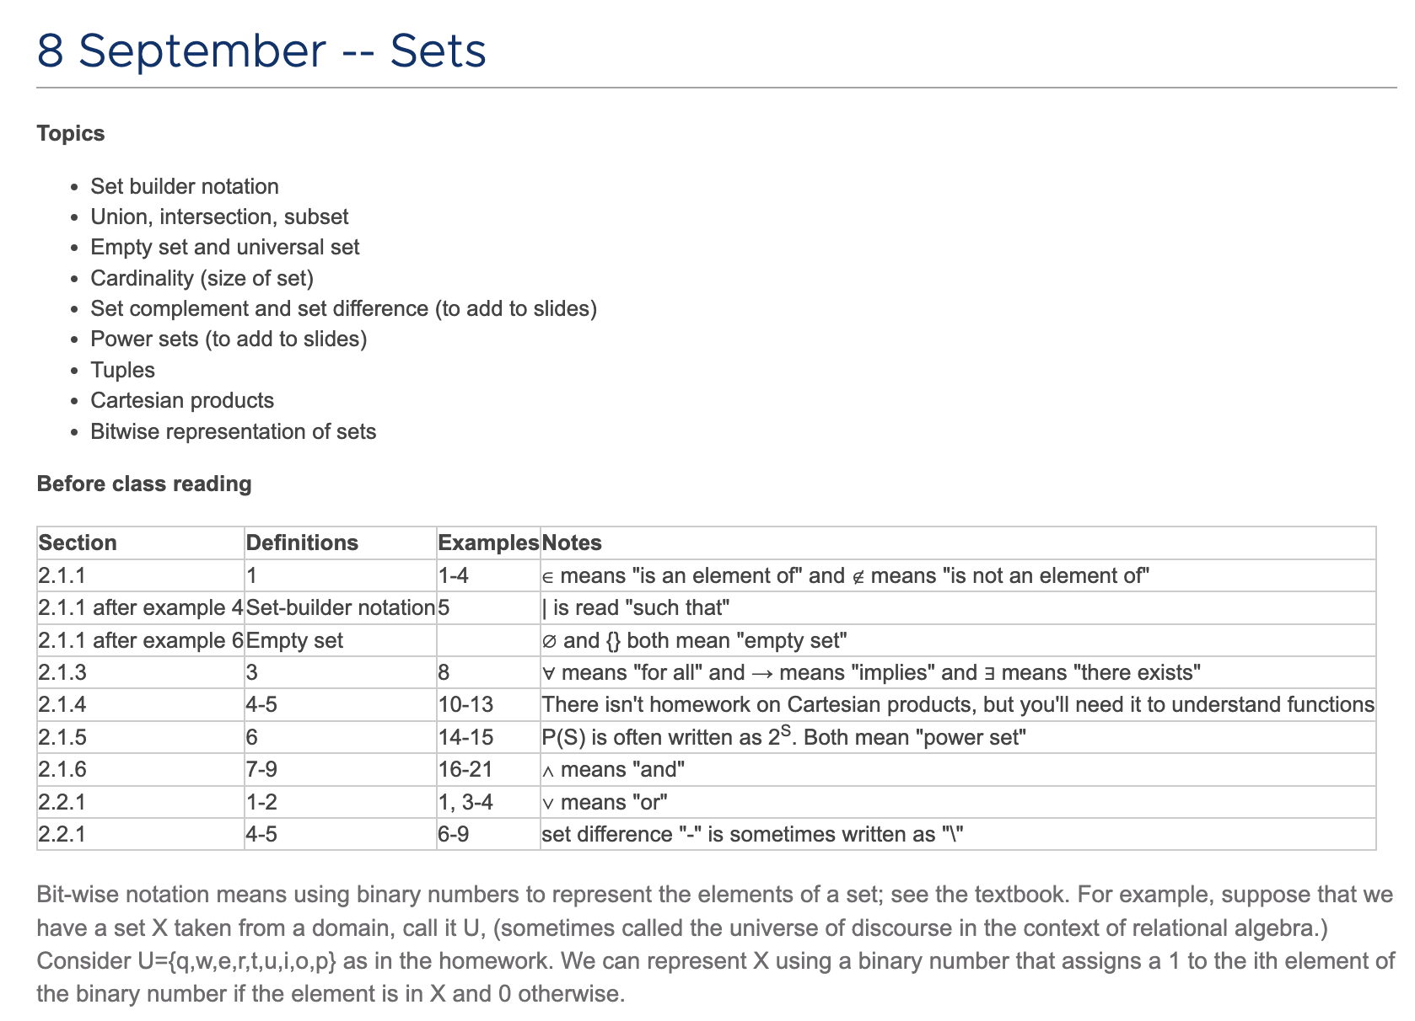
Friday’s lecture uses a ”flipped class” model.
Read before class
Work on HW in class
I’ll interrupt with discussions of tricky definitions (e.g., power set, Cartesian product)
Notes:
I try to use the lecture style that best matches the material rather than committing to all lectures or all flipped classes.

Slide 12
Clicking on what is due that day takes you to either
an online quiz,
a written assignment to be submitted by LS,

Slide 13
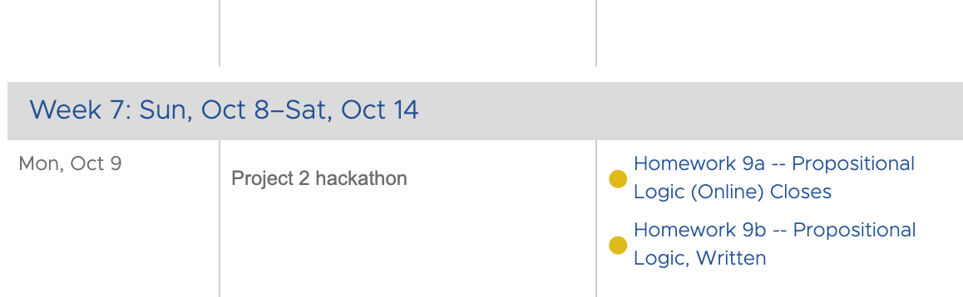
Clicking on what is due that day takes you to either
an online quiz, or
a written assignment to be submitted by LS,
sometimes both

Slide 14
Online homework assignments can be taken twice
feedback is given on what you got right or wrong so you can learn
Many online homework assignments require you to solve problems, so plan on having paper available
Homework is only worth 10% of your grade
learning versus assessment activities
don’t have to retake second time

Slide 15
Practice problems and solutions are posted
these are not maintained but might be helpful

Slide 16
Projects

Slide 17
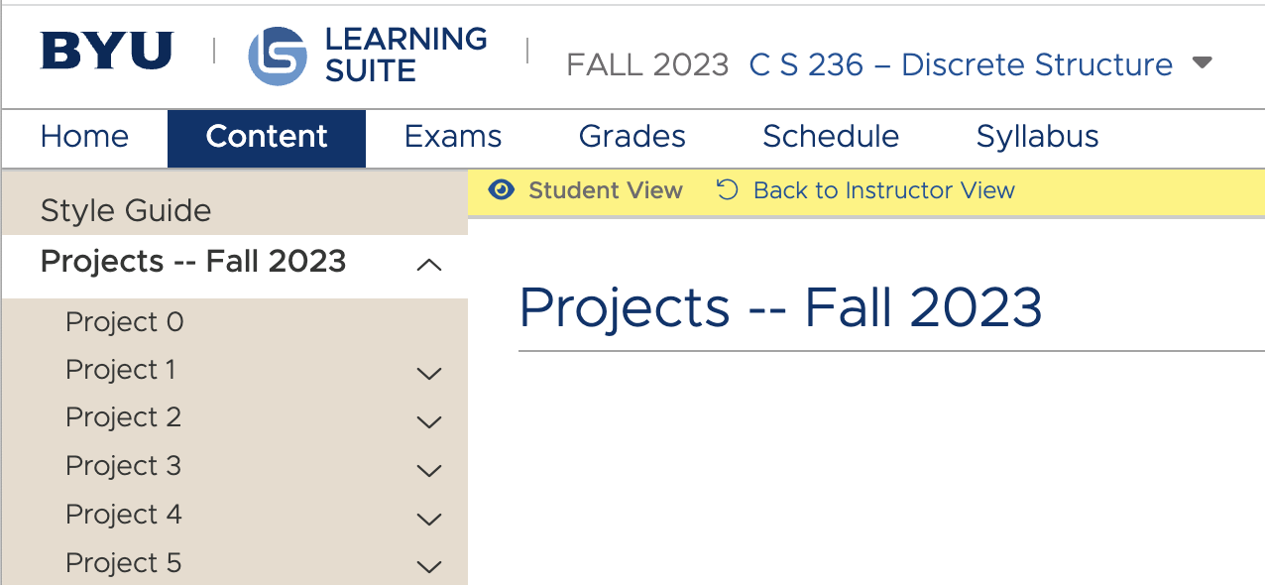
Access through schedule or directly through Content tab

Slide 18
Class Project – Datalog Interpreter
your Datalog program
Lexer
Parser
Execution
tokens
“meaning”
Mapping of Interpreter to Projects
Mapping of Schemas to Projects
Lexer: Project 1
Schema 1: Recognizers & Generators - Projects 1 & 2
Parser: Project 2
Schema 2: Logic & Relations - Projects 3 & 4
Execution: Projects 3, 4, & 5
Schema 3: Graphs & Algorithms - Project 5

Slide 19
Please use the Python style guide
but the style is not enforced

Slide 20
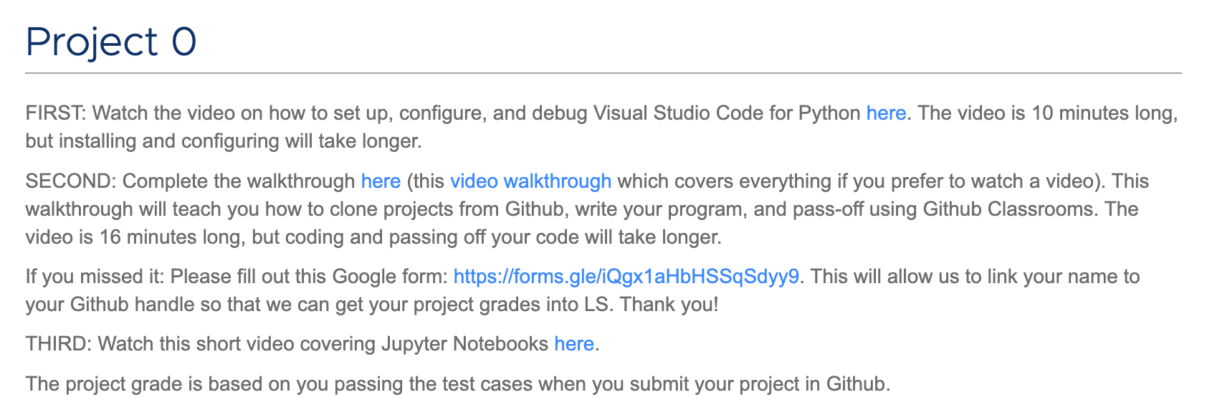
You can use whatever IDE you want, but TAs will only be able to help with Visual Studio Code

Slide 21
Passoffs will be through Github Classrooms
All test cases are available
Error feedback given on first three missed tests
No limit to number of times you can try to pass off

Slide 22
We have to match your github name to your netid, so please fill out this form

Slide 23
Python
Course will be taught using C++ in winter
Tutorials and videos should help you map math to code
What if I don’t know Python?

Slide 24
If you’ve passed the test cases, then we’ll get your grade recorded … … but it might take some time

Slide 25
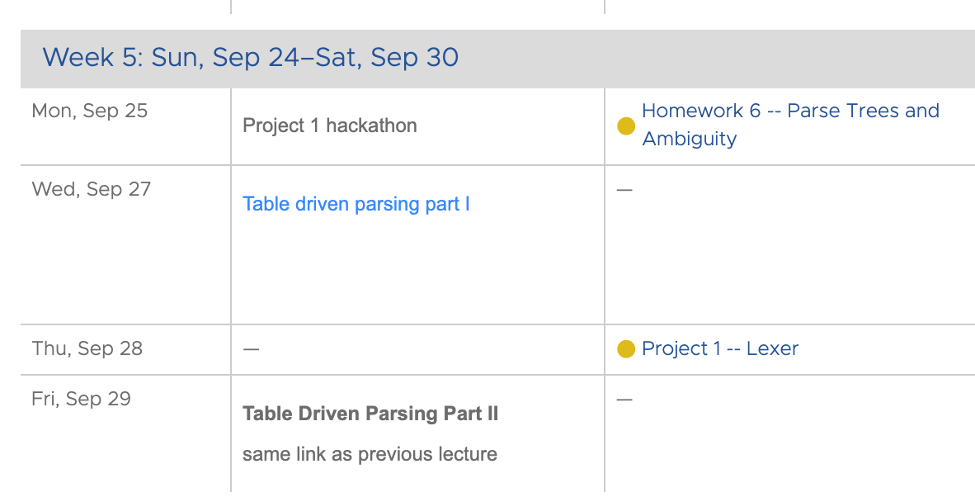
A few days before a project is due, we won’t have a traditional lecture
Instead, TAs will be in the classroom to help with the project
If you’ve completed the project, please come and help others

Slide 26
No homework due the day before or the day after a project is due
Hopefully, this will help a bit with workload balancing

Slide 27
Exams

Slide 28
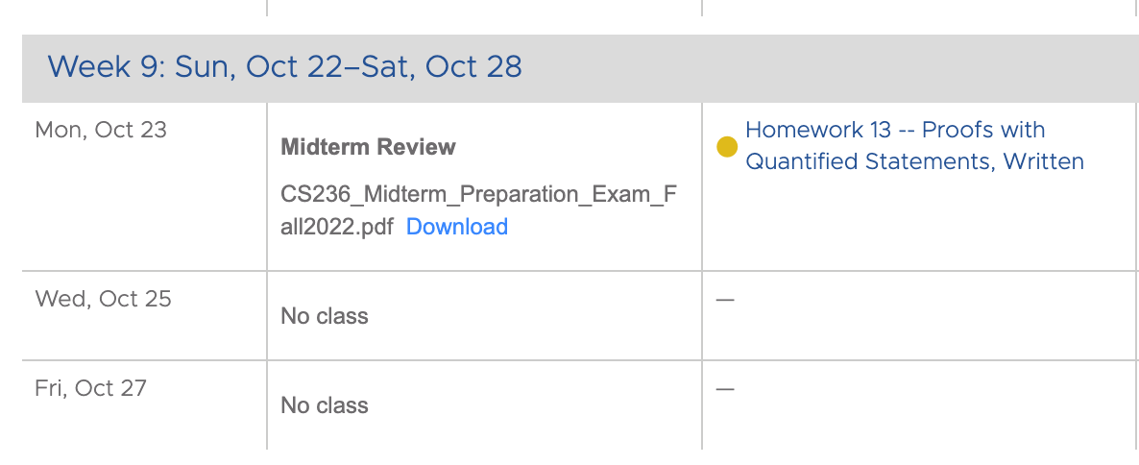
Two parts of exam
Preparation exam
Actual exam

Slide 29
Actual exam will be online via LS
Timed
Closed book except for one sheet of notes
Unproctored
Not Chat-GPT proof

Slide 30
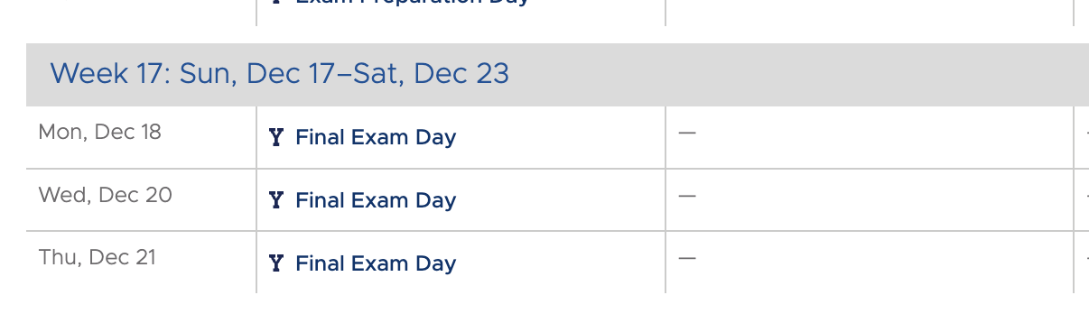
The final exam is online, not at a specific day and time
Take it when you like and where you like

Slide 31
Grades

Slide 32
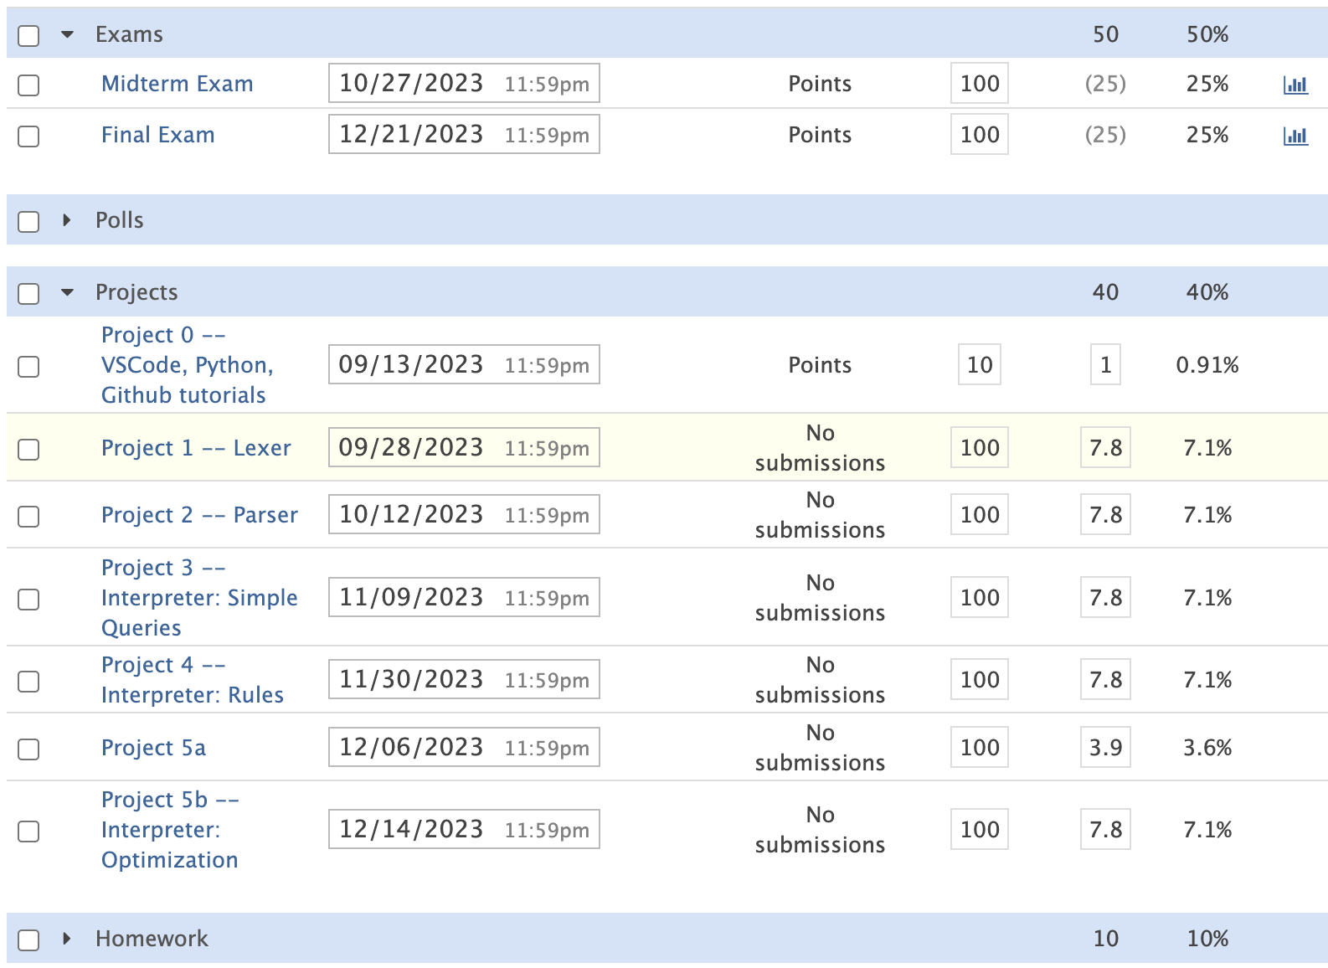

Slide 35
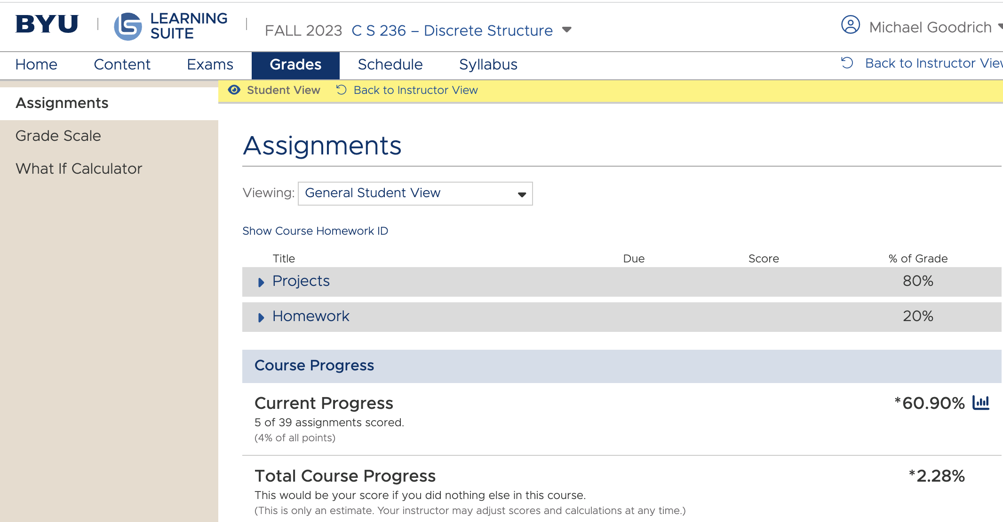
Don’t trust this
Until the midterm and final exam are published

Slide 36
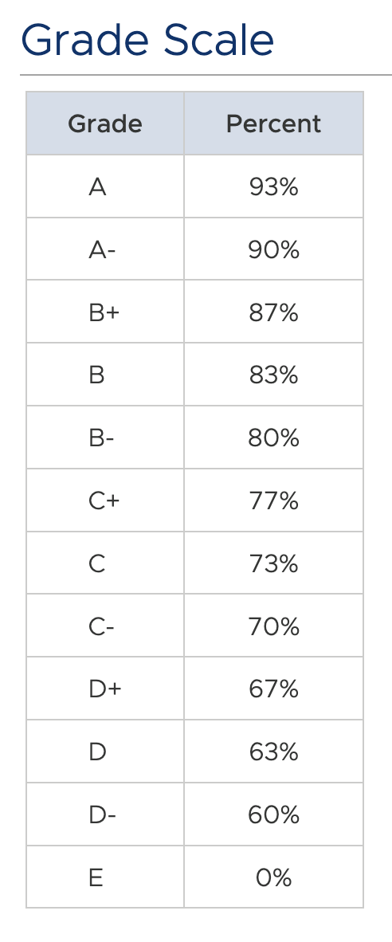
I reserve the right to lower these standards
In case I really mess up

Slide 37
Late and Early Days
Early pass-offs: +1 point per day (up to three days)
Late penalty: -2 points per day up to two weeks (excluding weekends)
Permission needed from instructor if passing off after two weeks

Slide 38
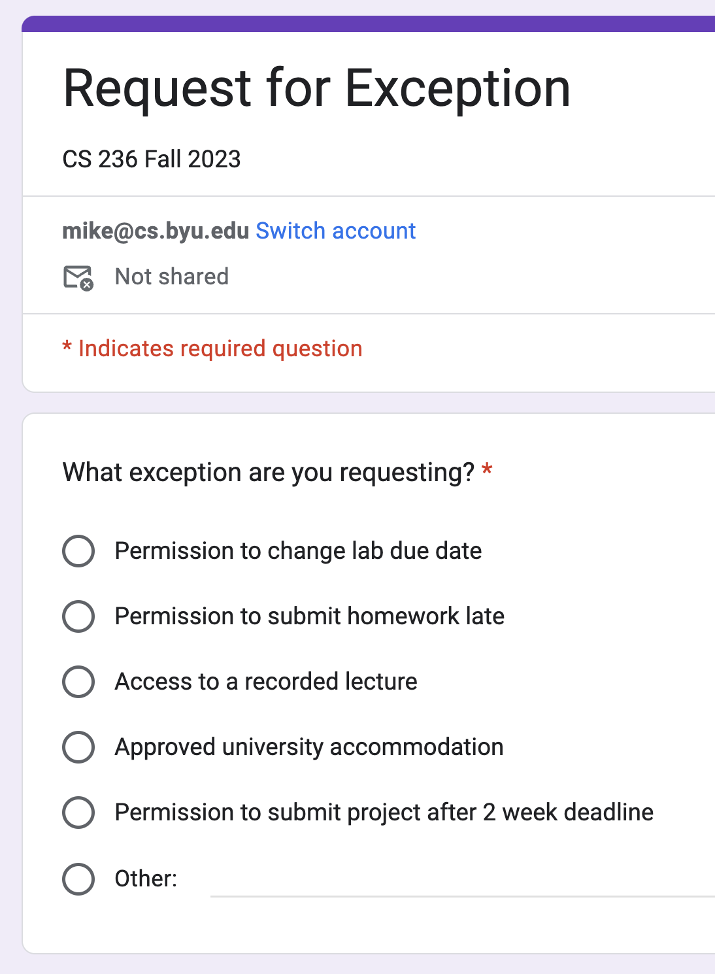
Please submit request for exception to late policy using the formed
Pinned to Discord #announcements
Under LS Announcements tab

Slide 39
I strongly prefer to not accept late homework assignments
They are worth so little of your grade

Slide 40
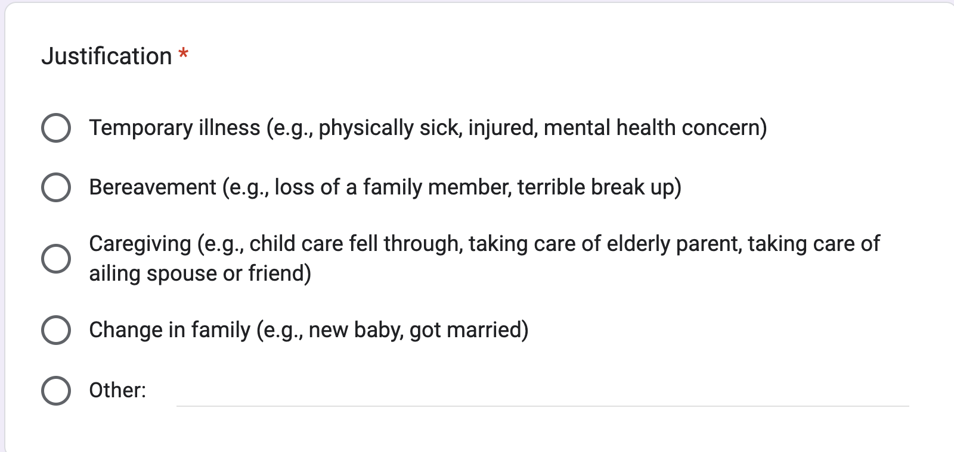
No difference between physical and mental health setbacks
I’m pretty generous, but please don’t take advantage of me

Slide 41
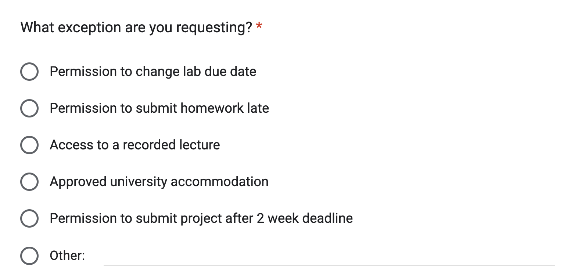
I prefer to not make exceptions for late homeworks
They are worth so few points in your total grade

Slide 42
Course Resources

Slide 43
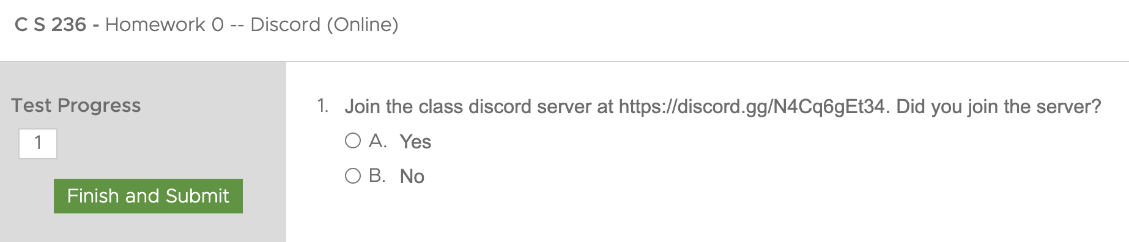
Class Discord channel

Slide 44
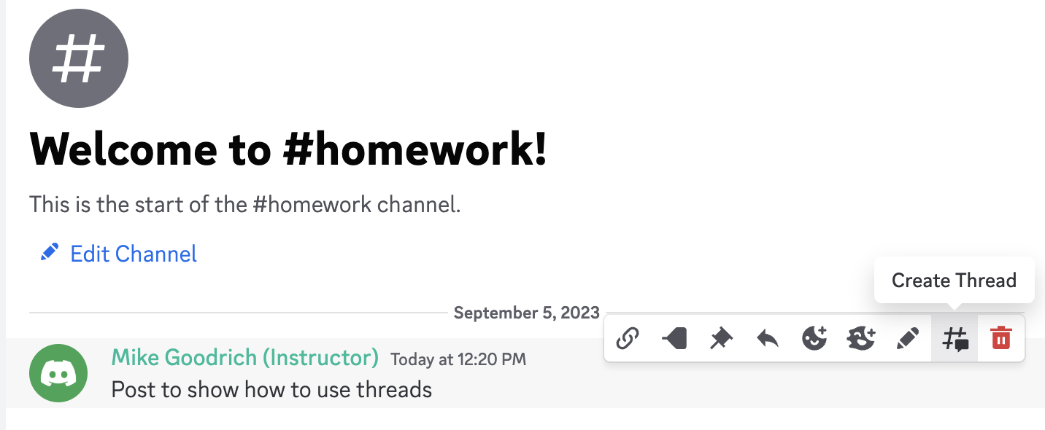
Class Discord channel
Use informative first line of message

Slide 45
Class Discord channel
Hover over first line to pull up options

Slide 46
Class Discord channel
Create a thread response if one doesn’t exist

Slide 47
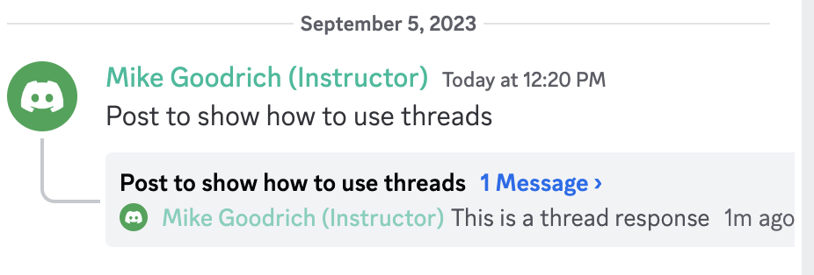
Class Discord channel
View other messages in thread

Slide 48
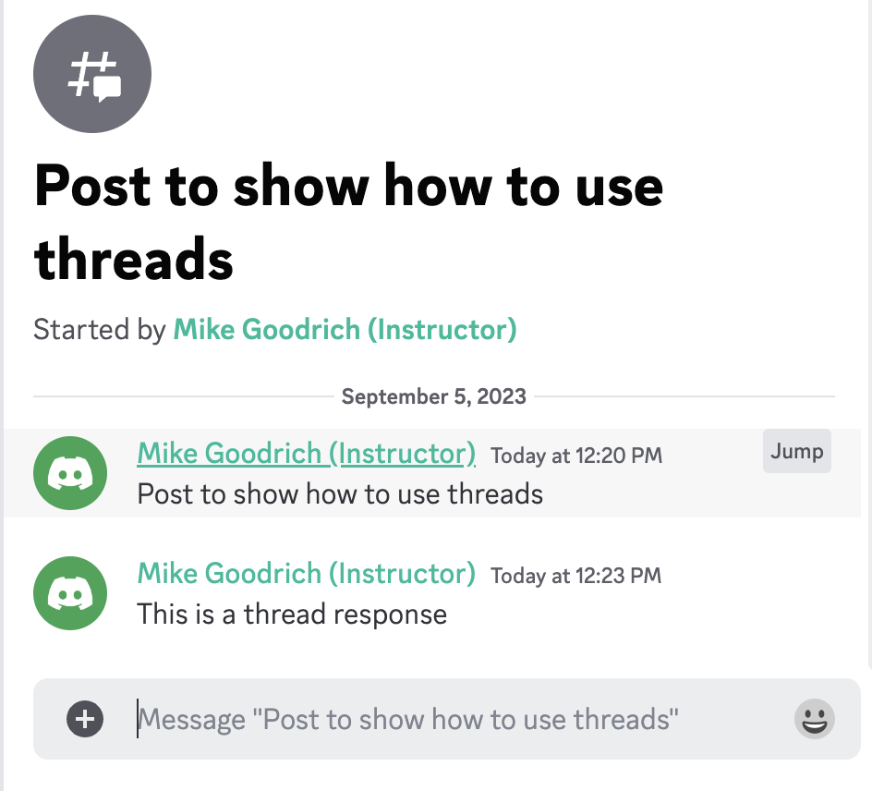
Add responses or follow up questions to the thread

Slide 49
Teacher
mike@cs.byu.edu from BYU email addresses only
Discord DM – probably the best option
LS messages -- expect delays
Text me if an emergency
e.g., exam won’t load
801-709-9937
Office hours MW 3pm others by appointment

Slide 50
TAs
Regular TA office hours
No Friday night
Via discord voice channel and in person
Proactive TAs

Slide 51
Textbook
Good book
Way too expensive
After the semester, use Wikipedia, YouTube, ChatGPT, or online tutorials
I suggest renting the textbook or buying the pdf
Available under course reserve in library – 2 hours at a time
see info on today’s lecture under course content on LS
7th edition?
International edition?

Slide 52
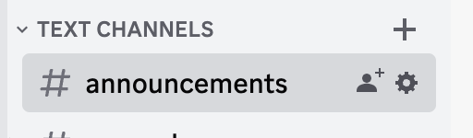
Blended Class Structure
I’ll stream every lecture on zoom
In case you can’t make it to class
A TA will monitor the chat and help answer questions
But I strongly encourage in class attendance
I’ll try to remember to record each lecture
Please request a link to the recording if you need it
I might forget … BYU no longer allows us to automatically record zoom meetings

Slide 53
Blended Class Structure
I’ll stream every lecture on zoom
In case you can’t make it to class
A TA will monitor the chat and help answer questions
But I strongly encourage in class attendance
I’ll try to remember to record each lecture
Please request a link to the recording if you need it
I might forget … BYU no longer allows us to automatically record zoom meetings
Linked pinned to Discord announcements
Also on LS Announcements

Slide 54
University Accommodations
I’m sincerely committed to working with students who need accommodations
Please work with the University Accessibility Center
And please let me know when we need to apply the accommodation

Slide 55
Make your life better
Best practices for succeeding in class

Slide 56
make your life Better – Part 1
Test-Driven or Iterative Development
Essence: write unit tests before coding small parts of the system
Pros: prevents the 20-hour, weekend-killing “bugs”; results in better code organization; results in faster overall development
Cons: you’ve probably never done it before and bad habits are hard to break; you’ll also probably think/feel you’re going slower – the truth is, debugging is always slower than testing

Slide 57
make your life Better – Part 2
Community of practice
Look at each others code
Help each other debug
Design together
Follow the discord discussions for each project
But don’t copy each other’s code

Slide 58
make your life Better – Part 3
Do the math part of the projects before writing code
Design your tests around the math part
Project 1 is way easier if you design the state machines first!
5 hours of programming can save you 30 minutes with pencil and paper

Slide 59
make your life Better – Part 4
Make sure your code passes all Test Cases
We give you every test case used in passoffs by the TAs
Don’t share these … other semesters of CS 236 do not have access to the tests

Slide 60
make your life Better – Part 5
Read and watch before class
I’ll let you know when I’ll assume you won’t have read before class
I recognize that you won’t always succeed at pre-class prep, but please do your best

Slide 61
make your life Better – Part 6
When to use Chat GPT
Interpret compiler errors
Understand example code
Generate support code
opening and accessing files
using exception handling
Give examples or explanations of math

Slide 62
make your life Better – Part 7
When not to use Chat GPT
Don’t use it to generate your code
Don’t use it exclusively – stackoverflow, geeks for geeks
Look for information about how to not do things
Don’t have it solve your homework problems
Don’t use it on exams

